Slide 1
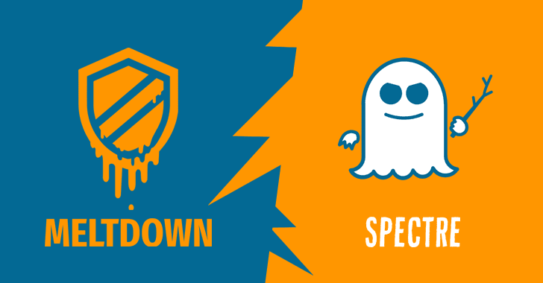
Done by S.KIRAN KUMAR
Spectre and Meltdown

Slide 2
What are Spectre and Meltdown?
Spectre and Meltdown are the names given to the variations of vulnerability that affects nearly every computer chip manufactured over the last 20 years.

Slide 3


History

Slide 4
What is speculative execution?
Speculative execution essentially involves a chip attempting to predict the future in order to work faster.
If the chip knows that a program involves multiple logical branches, it will start working out the math for all of those branches before the program even has to decide between them.

Slide 5
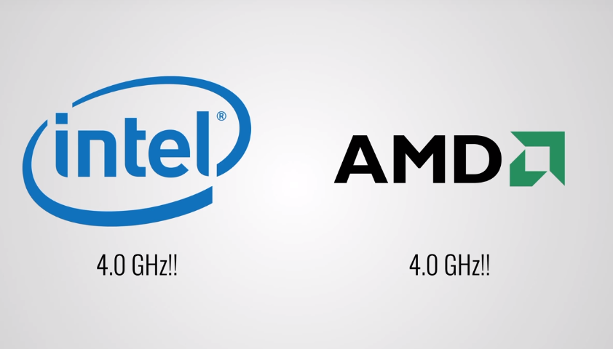
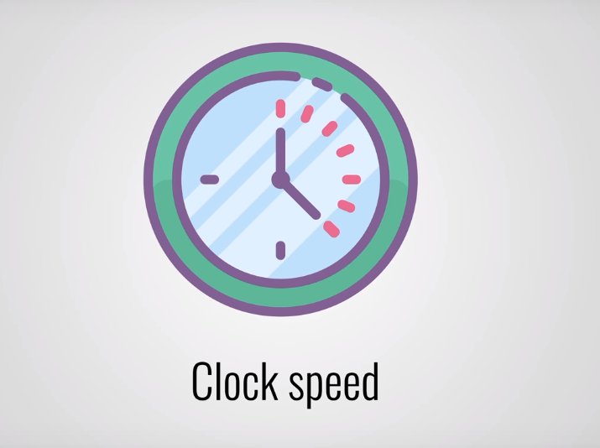

Slide 6
What is protected memory?
Protected memory is a type of memory that no process on a computer should be able to access data unless it has permission to do so.
This allows a program to keep some of its data private from some of its users, and allows the operating system to prevent one program from seeing data belonging to another

Slide 7
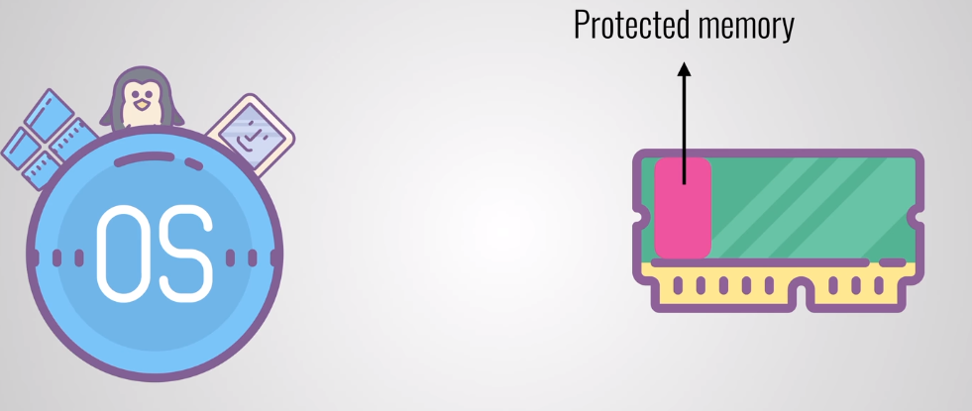
MELTDOWN Procted memory concept does not work when a cpu is Speculative that leaves a door open for exploits.

Slide 8
Spectre
For example, if the pattern of memory accesses performed by such speculative execution depends on private data in a system.
The resulting state of the data cache constitutes a side channel through which an attacker may be able to extract information about the private data using a timing attack

Slide 9
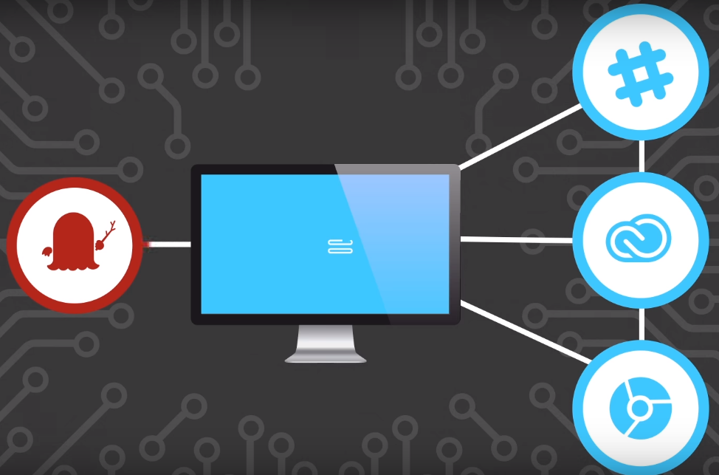
Spectre

Slide 10
PATCHES
Applying patches has been an ongoing process — and it's far from over. One day after the disclosure of Meltdown and Spectre, Microsoft released an out-of-band security update designed to provide mitigation for Meltdown (CVE-2017-5754) and Spectre variant 1 (CVE-2017-5753).

Slide 11

THANK YOU! Make sure you update your system to stop specter and meltdown

